Slide 1
Civil Liberties
A History of Curtailments During American Wars

Slide 2
Lecture Outline
Civil Liberties during a time of War
Quasi War with France (1798-1799)
Civil War (1861-1865)
World War I (1917-1918)
World War II (1941-1945)
Cold War (1950s)
Vietnam War (1965-1973)
War on Terrorism (2001-present)

Slide 3
Civil Liberties During War
Public safety often trumps civil liberties at home when America is at war
Quasi War with France (1798-1799)
Alien and Sedition Acts (1798)
President could deport any alien he considered dangerous
President could deport any alien from a country the US was fighting in war (i.e., French people in America)
Fines and imprisonment for those who made “false, scandalous or malicious statements” about federal officials
Fear of deportation led many French to leave America...14 newspaper editors were indicted, many others harassed by the government
At that time (late 18th century), President Adams and others felt that criticism of the government equated to the advocacy of overthrowing the government (and also equated to siding with the enemy)
When Jefferson became President, Alien and Sedition Acts were allowed to expire
Notes:
Just 10 years after the US Constitution was ratified, our government was at war with France and cracking down on freedoms at home. The media today makes “false, scandalous” and “malicious statements” about federal officials all the time. No one today worries about America being conquered by a foreign power. But in 1798, the survival of the nation was a real concern. President Adams viewed criticism of the government as a threat to the survival of the nation. Given that, many free speech rights we have today were denied then.

Slide 4
Civil Liberties During Wars
Civil War (1861-1865)
Lincoln suspended the Writ of Habeas Corpus during the Civil War, which only Congress has the legal power to do
Later the US Congress authorized Lincoln’s actions by passing the Habeas Corpus Act (1863)
The use of military tribunals in states outside of the theater of war were ruled unconstitutional by the Supreme Court in 1866 (Ex Parte Milligan (1866)), after the war’s end and after Lincoln’s death.
Mass Detentions – 13,000 mostly anti-war Democrats jailed in the North for discouraging volunteers to join the army and for helping the enemy (i.e., suspected of spying for the South)
The leading anti-war Democrat, Clement L. Vallandigham, was jailed; Lincoln then turned Vallandigham over to the Confederacy
Lincoln on Vallandigham: “Must I shoot a simple-minded soldier boy who deserts, while I must not touch a hair of a wily agitator who induces him to desert?”
Notes:
Habeas Corpus: Art. I, Section 9: “The privilege of the Writ of Habeas Corpus shall not be suspended, unless when in cases of rebellion or invasion the public safety may require it”.
Habeas Corpus gives a judge the power to call the executive branch to court to ask why a prisoner has been detained. If the judge believes the prisoner has been detained illegally, then the judge can release the detainee. This is a judicial check on the power of the executive branch (e.g., specifically, the police or military)
Lincoln suspended habeas corpus just after the bombing of Fort Sumter (which marked the beginning of the Civil War), and Lincoln ordered the commanding general of the northern army to detain anyone whom he believed might rebel against the union. Lincoln feared that Maryland would secede and then Washington DC would be surrounded by hostile forces, so he had good reason to declare martial law in that part of the country. A man named Merryman was detained and immediately had his lawyer challenge the case in a circuit court. The judge ruled against Lincoln’s suspension in 1861 (Ex Parte Merryman), citing that only Congress could suspend habeas corpus, but the judge did not have the power to force the arresting soldier to appear in court to give his reasons for detaining Merryman (the judge sent a US Marshall to Fort Sumter; the Marshall was turned away by the Northern army occupying the fort.)
Lincoln reinstated habeas corpus in 1862, in anticipation of the North winning the war, but the war went badly later that year, and Lincoln suspended habeas corpus again. Six months later, Congress passed the Habeas Corpus Act of 1863 authorized Lincoln’s suspension. After which, 1000s of anti-war Democrats in the North were jailed and denied habeas corpus rights for the remainder of the war.
See http://www.law.cornell.edu/supct/html/historics/USSC_CR_0071_0002_ZO.html for details on the ex parte Milligan (1866) case, which was decided after the war was over. The Habeas Corpus Act (1863) is discussed in detail in the court’s decision. There were exceptions to the suspension of habeas corpus in the law. For instance, if a detainee was not a prisoner of war and if the civilian courts were functioning, as they were in parts of the North, then a prisoner could petition a federal circuit court for his release, as Milligan did. Milligan was convicted and sentenced to be hanged by a military tribunal for raiding an army depot for arms and then plotting to free confederate prisoners being held in Indiana, but the court nullified that decision because the military tribunal system did not have jurisdiction over Milligan, since he was not operating in the theater of battle (the war did not extend to Indiana) and since he was not a member of the military and since the civilian courts were operating in Indiana at that time, according to the Habeas Corpus Act (1863), Milligan was entitled to a civilian grand jury proceeding, which did convene and handed down no indictment. In the end, Milligan was released. In passing, the US Supreme Court mentioned that the suspension of the writ of habeas corpus did not mean that a writ could not be brought to a court; the courts can still evaluate if a writ is applicable, even when Congress suspends habeas corpus.
Vallandigham was convicted and sentenced to 2 years in jail by a military tribunal in Ohio. His supporters were outraged and burned down the building that housed a pro-union newspaper. Under pressure, Lincoln refused to pardon Vallandigham; instead, he had him transported under military guard to Tennessee, where he was turned over to the Confederacy.
Lincoln worried that anti-war Democrats in the North would be spies for the South, so he had them jailed for the duration of the war. By today’s standards, this would be wrongful behavior, because it was a broad sweep of one entire demographic (Democrats protesting the war). By today’s standards, law enforcement or the military in this case is supposed to target only those who are actual spies, rather than all “suspicious” people of a certain demographic.

Slide 5
Civil Liberties During Wars
WWI (1917-1918)
Congress passed the Espionage Act of 1917 and Sedition Act of 1918
Espionage Act: criminalized activities discouraging the purchase of war bonds, military recruitment, and arms production
Sedition Act: banned speech that was “disloyal” to the government, Constitution, the military or the flag
Supreme Court upheld challenges to the two Acts
Schenck v. United States (1919) -- Anti-draft leaflets distributed by Socialist Party officials to military recruits constituted a “clear and present danger” to the United States
Gitlow v. New York (1925) -- Publication of the “Left-Wing Manifesto” in 1920, which advocated a change in government to socialism through the use of strikes and other forms of “class action,” also constituted a “clear and present danger”
Notes:
Woodrow Wilson was president during WWI.
In WWI, free speech rights were once again denied. Protest activities, such as discouraging the purchase of war bonds (which were needed for the government to pay for the war) and distributing fliers advocating socialism/communism, and “disloyal” speech aimed at the government were banned. Again, these measures are almost unbelievable by today’s standards, but at that time, it was thought that the government could not fight and win the war if people didn’t join the army or buy war bonds, so those who discouraged these types of activities were considered to be enemies of the state and were treated as criminals.
There are civil liberty advocates in every era of American history, so some of these civil liberty violations were challenged in the courts. The Supreme Court upheld the civil liberty violations in WWI. Advocating socialism/communism was considered to be a threat to the country at that time. Publishing a book on communism would be no big deal today because communism failed, but it wasn’t clear then if communism would prevail or if our system (democratic capitalism) would prevail. That’s why it was such a threat then.
-----------------------------
In 2023, Special Prosecutor, Jack Smith, has brought a criminal indictment against Donald Trump under the Espionage Act, for sharing a classified document (contingency plans to attack Iran) to people at one of his resorts who are not privy to see top secret material.

Slide 6
Civil Liberties During Wars
WWI (1917-1918)
Detentions: Attorney General, Mitchel Palmer, rounded up and jailed 197 anti-war radicals and members of the Industrial Workers of the World (IWW) socialist union
Eugene V. Debs, a leading socialist and socialist presidential candidate was also jailed
Notes:
President Wilson worried that socialists and communists would not be loyal to the country, that they would engage in some sort of “seditious” (wanting to overthrow the government) behavior, so he had them jailed for the duration of the war. By today’s standards, this would be wrongful behavior, because it was a broad sweep of one entire demographic (socialists and communists). By today’s standards, law enforcement (the Justice Department in this case) is supposed to target only those who are actually engaging in seditious behavior, rather than rounding up all “suspicious” people of a certain demographic.

Slide 7
Civil Liberties During War
WWII (1941-1945)
Japanese Internment -- Japanese Americans imprisoned during WWII
The US Supreme Court upheld the internment of the Japanese...the Court did not question the President, Congress, and the military’s authority to segregate Japanese-Americans from the rest of society
Hirabayashi v. United States (1943) -- The Court upheld Hirabayashi’s conviction for a curfew violation...he had violated an order to report to a “relocation center”
Korematsu v. United States (1944) -- The Supreme Court upheld Korematsu’s conviction for not reporting to a “relocation center”
In the 1980s, the US government paid a token reparation to the survivors of the Japanese-Americans interned during WWII
Notes:
The president (Franklin D Roosevelt), Congress, and the military worried that Japanese-Americans would side with their home country of Japan during WWII. To keep an eye on the Japanese-Americans, the government rounded them up and put them in detention camps for the duration of the war.
Hirabayashi and Korematsu were two Japanese-Americans who refused to report to relocation centers. They were later caught. Civil liberty advocates took their cases to the courts, and the Supreme Court eventually heard both cases. The high court sided with the government, upholding the detention of Japanese-Americans.
Fear of an invasion drove our government’s decision to place the Japanese in detention camps. Our leaders were convinced that Japan would attack the US homeland at some point during WWII and that Japanese-Americans might help in this effort. Fear of an invasion led to lights-out curfews all over the country. Under the curfews, people were required to shut off all of their lights in their homes, so that Japanese warplanes would not be able to bomb population centers at night. The Japanese invasion and air-strikes never occurred but the potential of an invasion occurring increased fear here at home.
By today’s standards, detaining Japanese-Americans just because they were Japanese and for no other reason was probably the worst civil liberty violation in US history. If any individual Japanese gave some sort of material support to the Japanese military, then it would be appropriate for law enforcement or the military to arrest that individual, but doing a broad sweep of an entire demographic (e.g., Japanese) is wrong by today’s standards.
In the 1980s, our government apologized to the Japanese who were detained in WWII and paid $20,000 to those Japanese who were still alive, or if they were no longer alive, to their families.
-------------------------------------------
Reparations are an issue today (2023). The State of California is considering paying a reparation payment to some of its black citizens for the harm that slavery has done to them.

Slide 8
Civil Liberties During War
Cold War (1950s)
Smith Act (1940) – passed by Congress prior to WWII but did not enforce it until the Cold War commenced in the late 1940s
Smith Act: banned the teaching or advocacy of overthrowing the US government by force or violence or by assassination
11 top members of the Communist Party of America were arrested in 1948, including its leader Eugene V. Dennis
The US Supreme Court upheld the Smith Act
Dennis v. United States (1951) -- upheld the jail sentences and held that communist advocacy represented a “grave and probable danger” to the US
Once the immediate fear of a potential communist overthrow subsided, beginning in the late 1950s, the Supreme Court began to strike down cases brought against American communists
Notes:
Harry Truman was president at the initiation of the Cold War, following WWII.
During the first few years of the Cold War, communists in America were jailed, and the US Supreme Court upheld these detentions.
By the early 1950s, it appeared that communism may take over the world. In the late 1940s, Eastern Europe came under the control of the Soviet Union, our communist Cold War enemy. Also, China turned to communism in 1950. Eastern Europe, the Soviet Union, and China comprised a good portion of the world map. The fear was that communism would take over America also. The Soviets preached this line, that grass-roots communism would eventually take control of our government.
Once the immediate threat of a communist takeover passed in the late 1950s, the Supreme Court began to protect the rights of communists. Believing in communism was protected under one’s freedom of conscience—the right to believe in what one wants.
Communists advocate the overthrow of the government, sometimes through violence. If there was a charismatic communist leader, who could plausibly encourage people to act to violence, then that leader could be jailed. But if there is no threat of violence, then communist rhetoric and writings must be tolerated (by government) in a free society.

Slide 9
Civil Liberties During War
Vietnam (1965-1973)
The FBI secretly (and illegally) monitored and wiretapped anti-war and civil rights leaders
These civil liberty abuses were exposed by the Church Committee (a US Senate investigation) in 1976
LBJ and Nixon both believed the Soviet Union was funding and encouraging American anti-war protesters
This is another example of perception trumping reality, the protesters sincerely opposed the war; there was no communist conspiracy
No Mass Detentions—Why?? – There were no mass detentions of anti-war protesters during the Vietnam War
The Supreme Court defined a new standard for free speech in Brandenburg v. Ohio (1969): the “direct incitement” test
Speech would be illegal if: “such advocacy is directed to inciting or producing imminent lawless action or is likely to incite or produce such action”
“Direct Incitement” is the standard used to this day
Notes:
Lyndon B. Johnson (LBJ), a Democrat, and Richard Nixon, a Republican, were the presidents in power during the Vietnam War.
In the Vietnam era (1965-1973), the government stopped jailing anti-war protesters. The Supreme Court created a new standard for free speech in a time of war—the direct incitement test. This allowed people to protest the government’s policies as long as their speech did not directly incite violence. Say, for example, if someone tries to incite a crowd of people to burn down a building, then that would be illegal, but if someone was encouraging people to dodge the military draft, that would be legal.
Though they weren’t jailed, the government illegally monitored anti-war protesters and civil rights advocates. Fear and paranoia drove this illegal government activity. Both LBJ and Nixon were convinced that the Soviet communists were funding anti-war protesters and the leadership of the civil rights movement.

Slide 10
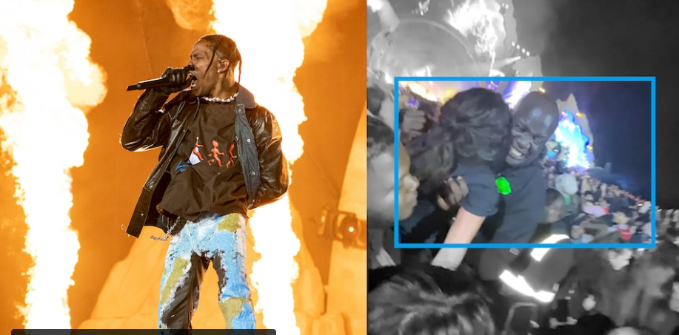
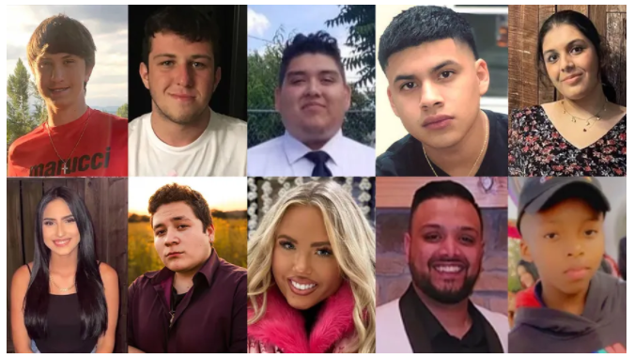
The Line Between Free Speech – Illegal Speech Not Guilty of “Direct Incitement” – Travis Scott (Musician)
10 Fans Died from “Crowd Surging” at the Astroworld Festival (Nov. 5th 2021)
Speech can become illegal when the speaker incites imminent (imminent is right now = direct) violence or lawless action
Incitement is possible when a charismatic speaker has an energized following of people and can influence a crowd to engage in violence or lawless action
10 people died at the Astroworld Festival (2021). The headliner, Travis Scott, may not be guilty of inciting “crowd surging” toward the stage, but he has been charged for inciting a riot at previous concerts in 2015 and 2017, pleading guilty to disorderly conduct (but not to incitement)
Notes:
Seven dead victims from Astroworld Festival were in one section of the audience, Washington Post investigation shows - Washington Post
https://www.washingtonpost.com/investigations/interactive/2021/what-happened-astroworld-travis-scott/ -- Here’s an article with graphics that explain what caused 10 fans to die at the Astroworld Festival on Nov. 5th 2021. Travis Scott was the headliner at the festival.
Astroworld: Travis Scott has been arrested before for inciting riots at concerts | Stuff.co.nz
https://www.stuff.co.nz/entertainment/music/126920432/astroworld-travis-scott-has-been-arrested-before-for-inciting-riots-at-concerts – This article details the previous concerts after which Travis Scott was charged with inciting a riot.
Incitement is very hard to prove in court, because we tend to favor a broad allowance of free speech in this country, so in the case of Travis Scott, prosecutors settled with Scott in 2015 and 2017, when he encouraged fans to storm a security barrier in one instance as well as encouraging fans to jump from a balcony in a second. Scott plead guilty to disorderly conduct in both cases, and prosecutors dropped the charge of inciting violence.
Like Travis Scott, Donald Trump also has an energized base of supporters, so Trump has to be careful about incitement. Trump was impeached for inciting a riot at the Capitol Building on 6 January 2021, but Trump’s words, “fight like hell,” were protected free speech, not incitement. Politicians from both political parties use the phrase “fight like hell” and never have those words incited a riot.

Slide 11
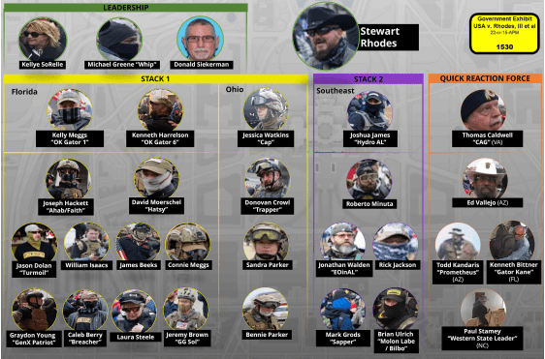
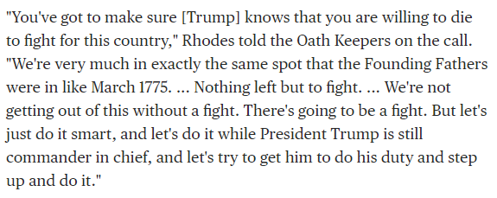
The Line Between Free Speech – Illegal Speech Guilty of “Direct Incitement” – Oath Keepers on Jan. 6th 2021 (Capitol Riot)
Oath Keeper Organization Chart
In November 2022, a jury found 5 members of the Oath Keepers guilty of obstructing an official congressional proceeding, as well as finding Stewart Rhodes and Kelly Meggs guilty of “seditious conspiracy”
Charismatic leaders like Rhodes and Meggs can command their followers to engage in imminent violence, so even though they did not give that command on Jan. 6th 2021 (Capitol Riot), they met the standard for illegal speech: being “likely to incite or produce…” violence or lawless action
Notes:
Oath Keepers Stewart Rhodes and Kelly Meggs found guilty of seditious conspiracy in Jan. 6 case (nbcnews.com) https://www.nbcnews.com/politics/justice-department/oath-keepers-verdict-seditious-conspiracy-trial-rcna58415 -- News about the jury verdict
18 U.S. Code § 2384 - Seditious conspiracy | U.S. Code | US Law | LII / Legal Information Institute (cornell.edu) https://www.law.cornell.edu/uscode/text/18/2384
If two or more persons in any State or Territory, or in any place subject to the jurisdiction of the United States, conspire to overthrow, put down, or to destroy by force the Government of the United States, or to levy war against them, or to oppose by force the authority thereof, or by force to prevent, hinder, or delay the execution of any law of the United States, or by force to seize, take, or possess any property of the United States contrary to the authority thereof, they shall each be fined under this title or imprisoned not more than twenty years, or both.
Oath Keepers Role on Jan. 6th 2021
The Oath Keepers’ leadership were organized on Jan. 6th 2021 (during the Capitol Riot) to serve as Donald Trump’s army/police force had Trump invoked the “Insurrection Act” (as it turns out, Trump did not invoke the Insurrection Act on Jan. 6th 2021). In Nov. 2022, two of five of the Oath Keepers’ leadership were found guilty in court of “seditious conspiracy.” On Jan. 6th (2021), the Oath Keepers engaged in no violence (except maybe some of their 300 or so members engaged the Capitol police, but what I mean is that they did not pull out their weapons and start shooting in an effort to take control of the Capitol Building on behalf of Donald Trump), but their leadership had an energized following, who would have pulled their weapons and killed had the Oath Keepers leadership commanded them to do so, which is why two of 5 leaders of the Oath Keepers were found guilty of conspiring to incite violence or lawless action (even though their followers ultimately did not engage in violence or lawless action, at least not in the context of trying to takeover the U.S. government). “Conspiracy” means planning and plotting but not actually putting the plan/plot into action, so violence or lawless action does not necessarily have to occur for a leader with an energized following to be found guilty of “seditious conspiracy.”
Proud Boys Role on Jan. 6th 2021
Four Proud Boys members found guilty of seditious conspiracy in Jan. 6 trial (nbcnews.com) https://www.nbcnews.com/politics/justice-department/jury-reaches-verdict-proud-boys-seditious-conspiracy-trial-rcna81129
In May 2023, four (4) leaders of the Proud Boys were convicted of seditious conspiracy. Like the Oath Keepers, the Proud Boys have an energized following, a hierarchy of command, who would act if commanded. Enrique Tarrio was not in Washington DC on Jan. 6, and he was also found guilty of seditious conspiracy, reason being is because Tarrio is a leader who has people who would act on his command. So, actual violence does not have to occur, just the likelihood violence or lawless action could occur upon command is enough for charismatic leaders to be found guilty of conspiracy.

Slide 12
Civil Liberties During War
War on Terrorism (2001 - Present)
Civil liberty protections have grown stronger over time, and this fact frustrated the previous Bush administration, which wanted powers that past wartime presidents have had
The Patriot Act – passed by Congress shortly after the 9/11 attacks and renewed in 2006
Civil liberty advocates oppose provisions that allow law enforcement to infiltrate anti-war groups or mosques without suspicion of a crime…under normal law enforcement activities, a person or group must be engaging in suspicious activity before law enforcement can go undercover to investigate
Civil liberty advocates also oppose the material support provision, which gives Congress the power to punish humanitarian organizations who give aid to groups that the State Department considers terrorist organizations
Both provisions have survived challenges to the US Supreme Court and remain the policy of our government
Supreme Court Decisions – The Supreme Court frustrated the previous Bush administration by curtailing some of the president’s powers during war
Notes:
George W Bush was president at the outset of the War on Terrorism.
The Patriot Act - designed to help the FBI collect evidence on terrorists and fight the war on terrorism:
Expands wiretapping of people who use multiple cell phones rather than for one phone only, though these wiretaps still require a warrant from a judge
Breaks down “wall” that prevented FBI criminal investigators from sharing information with FBI and CIA intelligence officers
Allows Attorney General to detain aliens suspected of terrorist activities until deportation
FBI can spy on domestic groups (i.e., anti-war groups and Muslims) without suspicion of a crime at internet sites, public meetings, and religious gatherings
Authorizes the Justice Department to hold “material witnesses” indefinitely without charge if it is believed the suspect has evidence of terrorist activities (modified by US Supreme Court in a series of decisions)
Authorizes monitoring of conversations between detainees and their lawyers
Authorizes banks to monitor and compile data on individual transfers to discern suspicious patterns (3rd party cooperation)
Source: http://www.commondreams.org/news2007/1211-08.htm
“The ACLU filed an amicus brief in 2006 on behalf of humanitarian organizations including Oxfam, Operation USA, and the Unitarian Universalist Service Committee, all of which are concerned that the law interferes with their ability to provide humanitarian aid to desperately needy civilian populations. In the brief, the ACLU argued that sweeping provisions of the Patriot Act barring expert advice or assistance or training to groups considered terrorist organizations by the State Department prevented humanitarian groups from providing aid in war-torn areas, because in those areas it is sometimes impossible to provide aid without working with or through organizations that engage in both lawful and unlawful activity.”
Holder v. The Humanitarian Law Project (2010)
The Humanitarian Law Project sought to educate the Kurdistan Workers Party in Turkey and the Tamil Tigers in Sri Lanka on how to resolve conflict peaceably, without violence. The Supreme Court ruled against the Humanitarian Law Project, stating that the law prohibits “training” and “expert advice” and “personnel” to an organization that Congress declares as a terrorist organization, even when the aid is intended to promote peaceful resolution of conflict or work through UN processes.

Slide 13
Civil Liberties During War
War on Terrorism (2001 - Present)
Supreme Court Decisions – continued.
Bush wanted to detain prisoners caught in the field of battle for the duration of the war on terrorism without trial or access to lawyers, in order to squeeze intelligence information out of detainees that might prevent the next terrorist attack
In three decisions, the Supreme Court would not allow permanent detentions without a trial: detainees are entitled to challenge their detentions in court through the right of Habeas Corpus (Prisoners at Guantanamo Bay (2004) & Hamdi (2004); Boumediene (2008))
Also, the Supreme Court struck down the Bush administration’s use of military commissions (Hamdan decision (2006)) because they did not conform to US military or international standards, nor were they authorized by Congress
In addition, the Supreme Court has imposed international standards for interrogation techniques of prisoners to prevent the US from engaging in torture
Notes:
In compliance with the Hamdan Supreme Court ruling, Congress passed and the president signed the Military Commissions Act (2006) in Oct 2006. In the act, Congress authorizes the president to establish military commissions to try enemy combatants. The president is also authorized to set regulations (punishments) for those who commit non-grave breaches of the Geneva Convention. Thus, the president will define what is a non-grave breach (perhaps even regarding the rules on torture). What makes the Military Commissions Act controversial was its removal of Habeas Corpus rights for enemy combatants. In Boumediene v. Bush (2008), the US Supreme Court, in a 5-4 decision, reinstated Habeas Corpus rights to prisoners held in the war on terrorism. The portion of the Military Commissions Act that denied Habeas Corpus rights for enemy combatants was overturned and ruled unconstitutional.
With respect to prisoner treatment, “grave breaches” of the Geneva Convention are: torture, cruel or inhuman treatment, performing biological experiments, murder, mutilation or maiming, rape, causing serious bodily injury, and sexual assault or abuse, and taking hostages. Clearly, rape or murder needs no further clarification. But what about torture? Or cruel and inhumane treatment? These need definition. The president is obligated to publicly pronounce what defines a non-grave breach of the Geneva Convention, that is crimes that are less severe than the “grave breach” standard, but definitions of these lesser crimes can be vague also, not necessarily identifying specific interrogation techniques. Once the president makes his interpretation of non-grave crimes public, there will be legal battles over certain interrogation techniques. The president (either Bush or a future president) will argue that a certain technique does not constitute grave or even a non-grave breach, but civil liberty advocates will argue that it does violate the Geneva Convention. We will continue to fight about interrogation techniques until this country settles on an acceptable standard.
On the issue of secret evidence in military commissions, detainees on trial will be given the “substance” of the evidence against them but methods and sources in obtaining that evidence will remain classified. For instance, if there was evidence that the detainee was going to pick up a bomb but was arrested before doing so, the detainee would be informed that the US government had evidence of the bomb and his intentions to explode it and kill people, but the people and methods used to get that evidence would remain secret. This was the compromise struck.

Slide 14
Civil Liberties During War
War on Terrorism (2001 - Present)
The Obama Administration – President Obama tried to moderate former Bush administration policies, by ordering the closing of the Guantanamo Bay detention facility (though Congress has required the facility to remain open) and by ordering new standards of interrogation for detainees
On balance, Obama favored civil liberties but faced stiff resistance from a foreign policy/defense culture that leans toward public safety—Obama was influenced by this culture:
Obama called for “prolonged detentions” of prisoners who may have been tortured (which would disqualify evidence obtained from court) but who remain a threat to the country
Obama continued to use military commissions to try terror suspects (civil liberty advocates want terror suspects to be tried in civilian courts
Obama continued Bush’s NSA spying program (collecting phone calls and internet activity)
Edward Snowden exposed much of the spying program during the Obama administration…Russia is protecting Snowden, refusing to turn him over to U.S. prosecutors
Notes:
Barack Obama was the second post-9/11 president.
The Bottom Line – Future US presidents will not have the powers of past wartime presidents…the war on terrorism is different—it’s part war, part crime-fighting…the Supreme Court does not considered it an all-out war like WWI or WWII

Slide 15
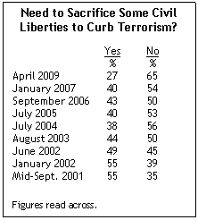
Civil Liberties v. Public Safety The Effect of a Major Terrorist Attack on Public Opinion
The US has not suffered a major terrorist attacked in ~18 years, and fear of another attack has subsided some
Public support for civil liberties tends to trump the desire for more public safety when the country moves toward a peace-footing
Notes:
Source: Pew Research Center Poll (5-21-09)
Some “lone wolves” have slipped past homeland security and have carried out their terrorist attacks; these would include the terrorists attacks at Fort Hood (13 dead; 30 injured), at the Boston Marathon (4 dead; many injured), and at the military recruiting centers in Tennessee (5 dead).

Slide 16
Conclusion
Typically, presidents of both liberal and conservative ideology tend to favor public safety over civil liberties in a time of war
This was true of Obama also, though he wanted to favor civil liberties more
When war is an obvious threat to the home-front, leaders feel an overwhelming responsibility to protect the public from its enemies
It’s a mindset: “National security comes first, even at the expense of a few civil liberties”
Moreover, in an atmosphere of fear, the public is much more tolerant of the exercise of government police power (i.e., public safety at the expense of civil liberties)

